Slide 1
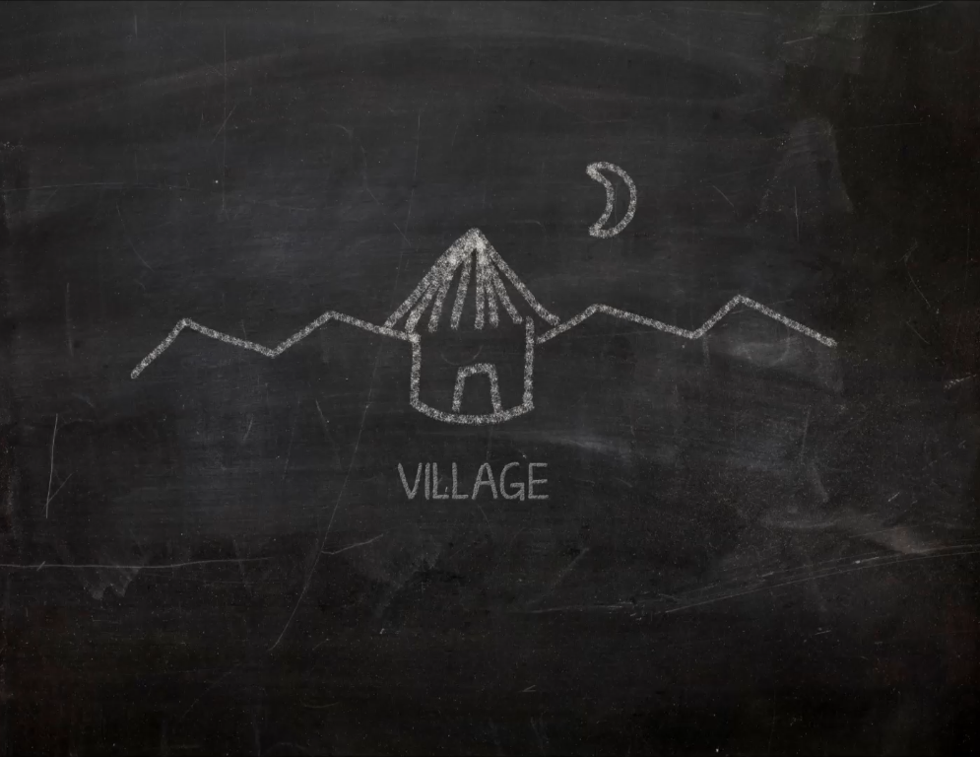

Slide 2
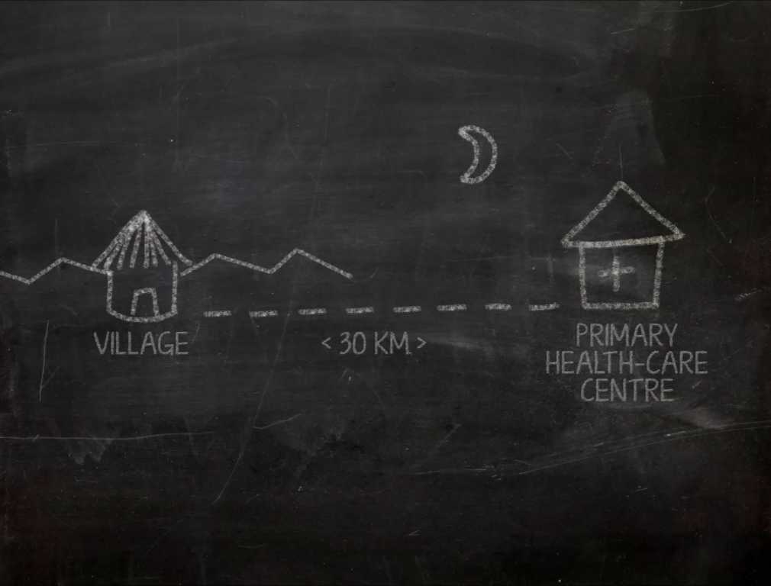

Slide 3
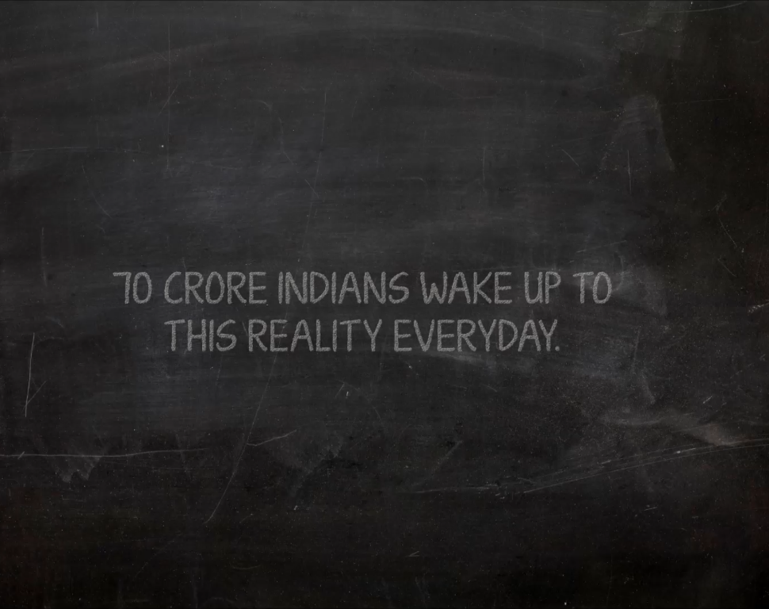

Slide 4
Not a product, but a DREAM!

Slide 5
Both a PRODUCT & a DREAM
I have a dream!

Slide 6
The product, first.....

Slide 7
Smart e- stethoscope
HR Infra-red pupil monitor
Vital Stat wristband
EKG monitor

Slide 8
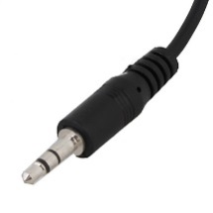
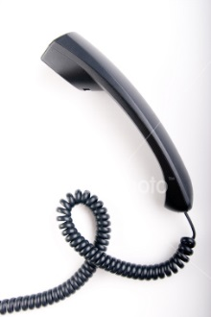
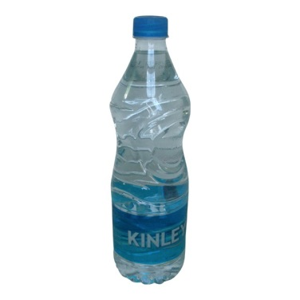
What good can come out of these?
Landline receiver microphone
A plastic bottle cap

Slide 9
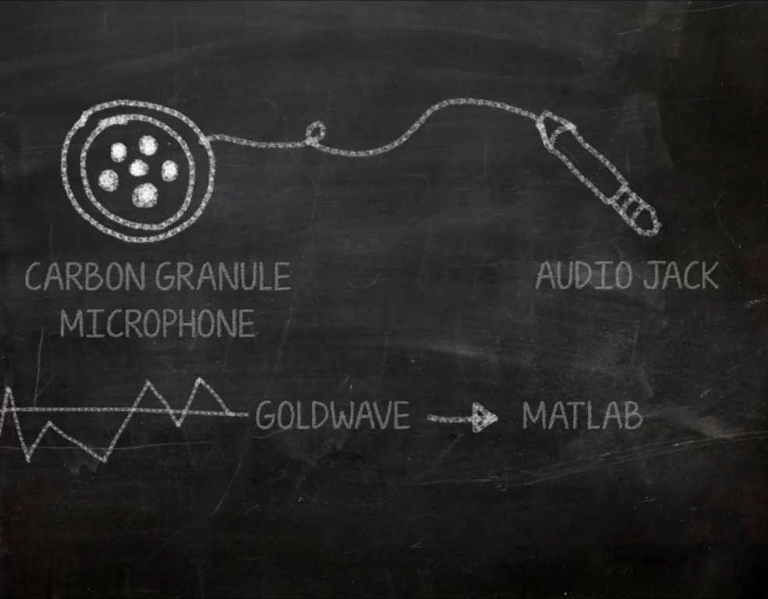

Slide 10
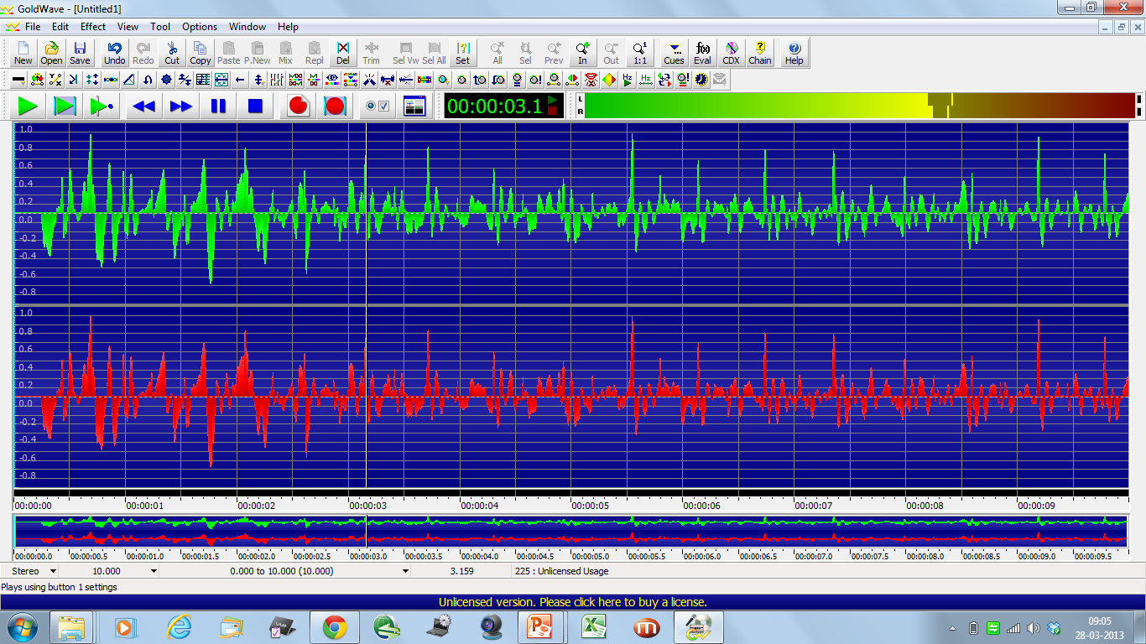
Stethoscope( phonocardiogram)
- Heart Sounds (S1, S2 and murmurs)
Respiratory sounds ( Bronchial and vesicular)
Fetal heart sounds
- Bowel Sounds
Pulse of a billion

Slide 11
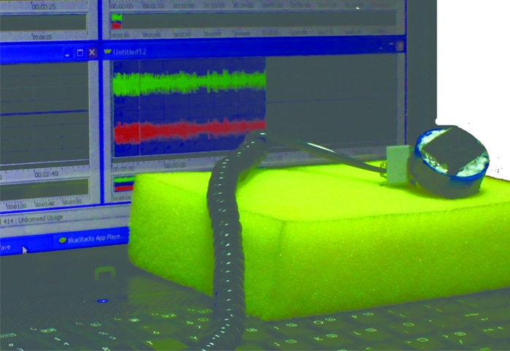
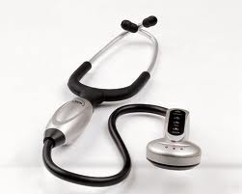
Works just as good or even better….
30,000INR
Our Smart E steth (prototype)
30 INR

Slide 12
Murmurs
Systolic
Diastolic
Pan systolic
End diastolic
Crescendo-decrescendo
With opening snap
Mitral Regurgitation
Aortic Stenosis
Aortic Regurgitation
Mitral Stenosis

Slide 13
Sounds like e- waste..
A webcam
A binocular case

Slide 14
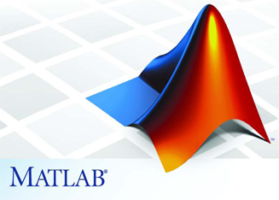
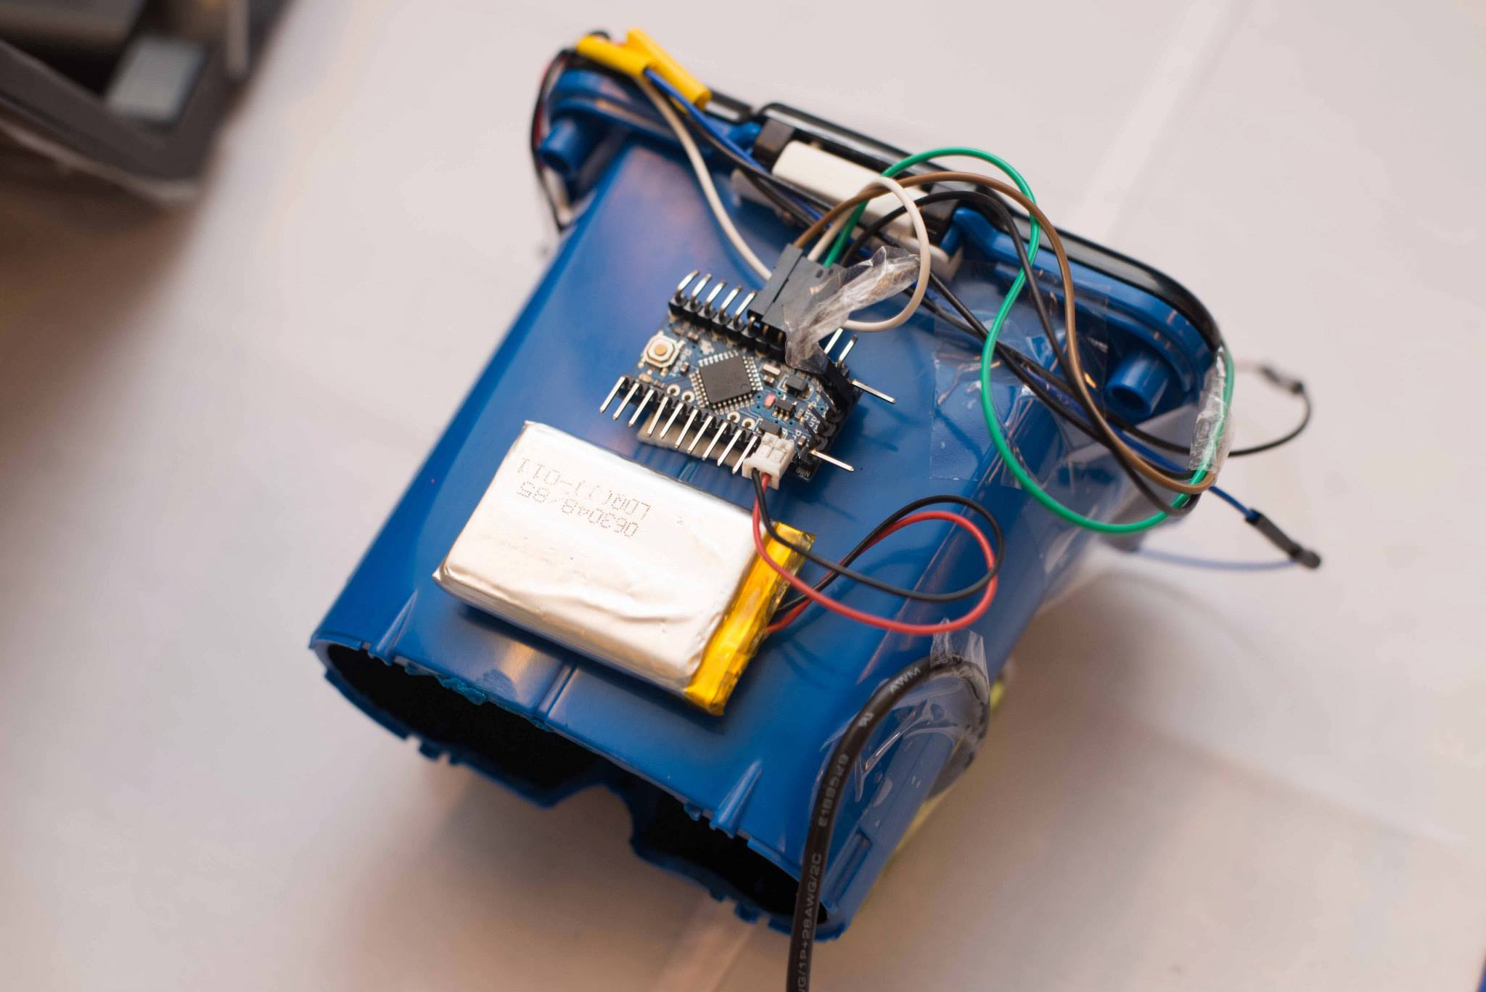
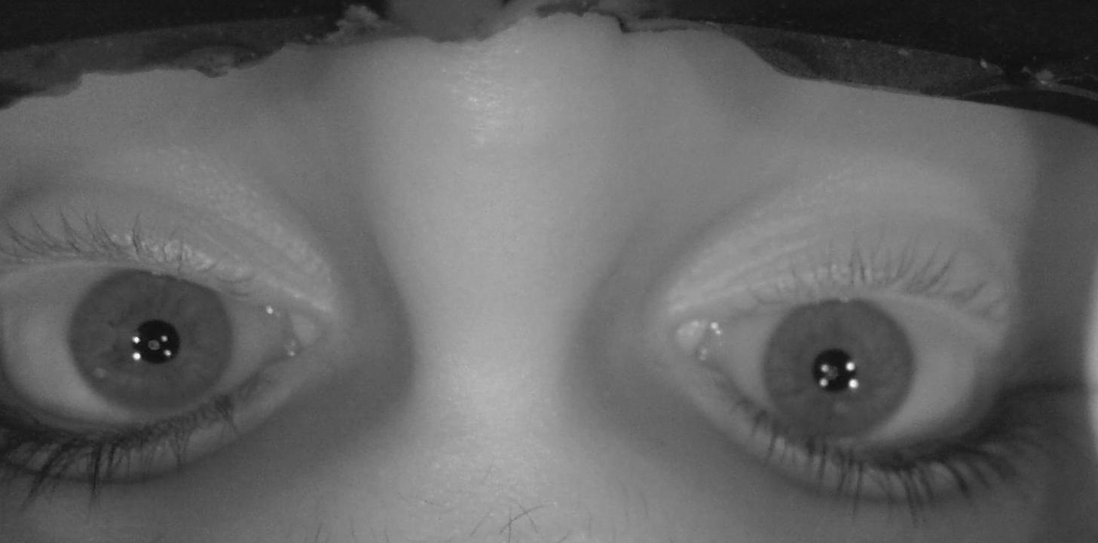
HR IR pupil tracker
- Iris reaction time
Cataract
Glaucoma
Squint
White to white distance
-Tone of sympathetic system
-Pupil size and shape
Pulse of a billion

Slide 15
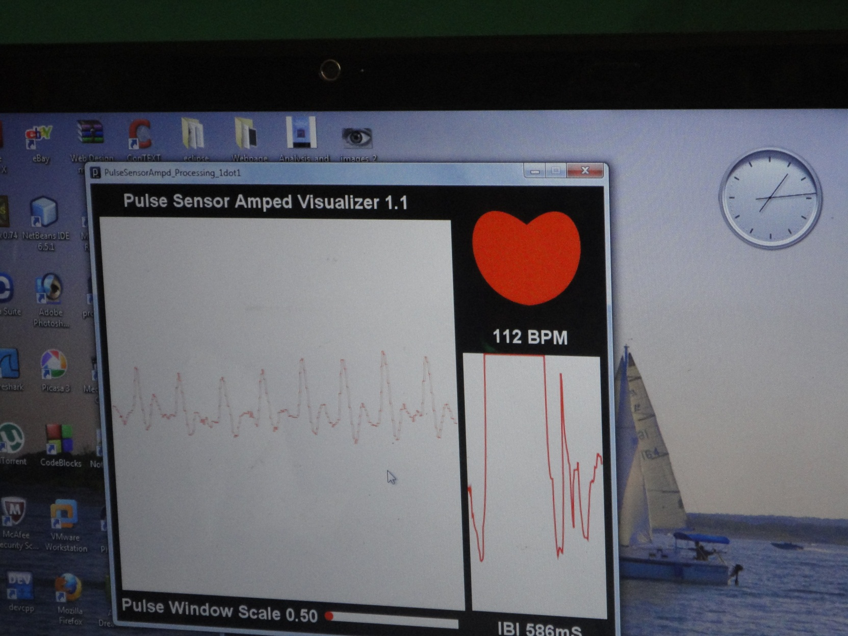
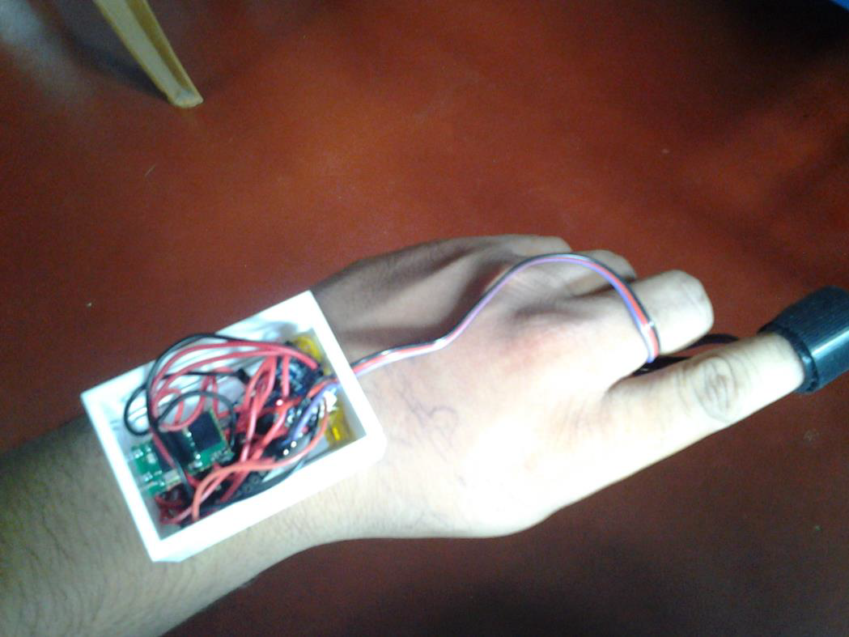
VS wristband
Pulse rate
Blood Pressure
Pulse Wave
Respiratory rate
Pulse of a billion

Slide 16
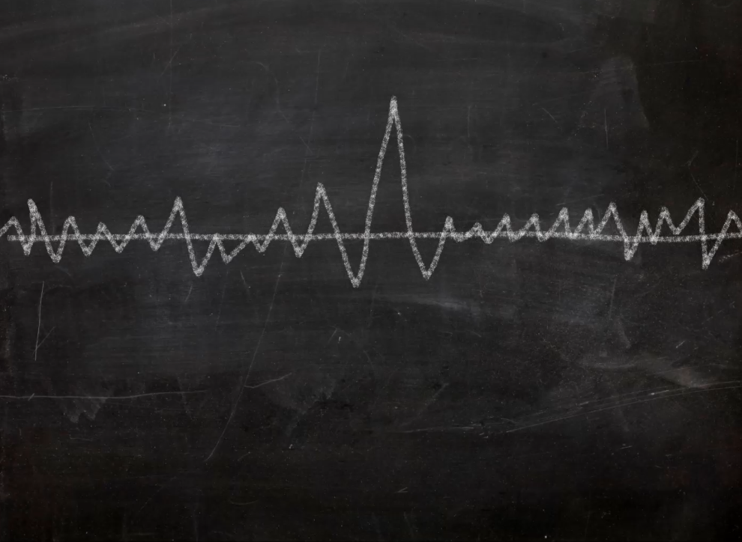

Slide 17
Pulse wave patterns
Pulses parvus tardus
-Heart Failure
Pulses Dichroticus
-Enteric Fever
- Dilated Cardiomyopathy
Pulses alterans
-Left ventricular failure
Pulses Bisfirience
-Asthma
- Aortic Regurgitation
Pulses bigeminus
-Ventricular bigeminy

Slide 18
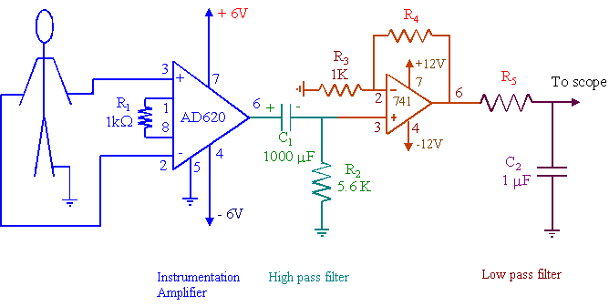
EKG monitor
Pulse of a billion
EKG monitor
-Systolic pressure
-Myocardial Infarction(heart attack)
-Arrhythmias
-Heart blocks

Slide 19

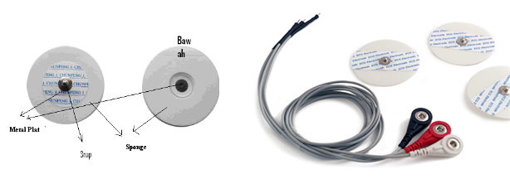

Pulse of a Billion Kit

Slide 20
Effectiveness
Stethoscope – 92% sensitive and 90% specific
HR IR pupil tracker – 90% sensitive and specific for cataract detection
Pulse meter- 96% sensitive and specific
*Sample size of 10 patients at St. John’s Medical College, Bangalore

Slide 21
Pheochromocytoma
Hyperthyroidism
Jaundice
Reynold's syndrome
Hirschprung's
Heart Disease
Microalbuminuria
Corneal edema
Horner's syndrome
Nephritis syndrome
Nephritis syndrome
Corneal ulcers
Argyl Robertson pupil
Fetal emergencies
Cushing's Syndrome
Hypertension
Cataract
Asthma
Bronchiectasis
Emphysema
Pleural effusion
Diabetes Hypertension
Aortic stenosis
Pulmonary stenosis
Portal hypertension
Abdominal obstruction
Rheumatic heart fever

Slide 22
USP
Not FANCY, But EFFECTIVE
Exist not only on our slides, but also as a prototype
Healthcare in the remotest area by exploiting existing framework......

Slide 23
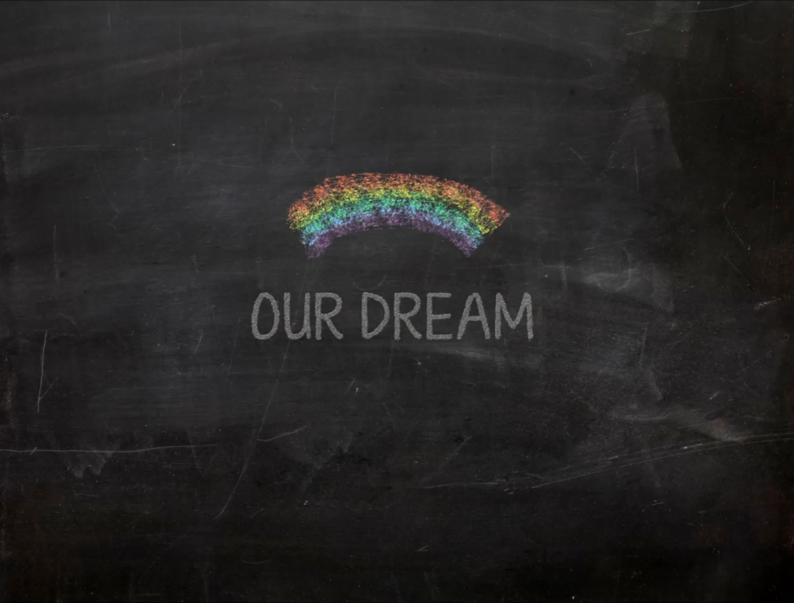

Slide 24




WLAN
Signs & Symptoms
Diagnosis & Treatment
ASHA

Slide 25




Village
WLAN
Signs
Diagnosis
Primary health care center
Village
Village
Village

Slide 26
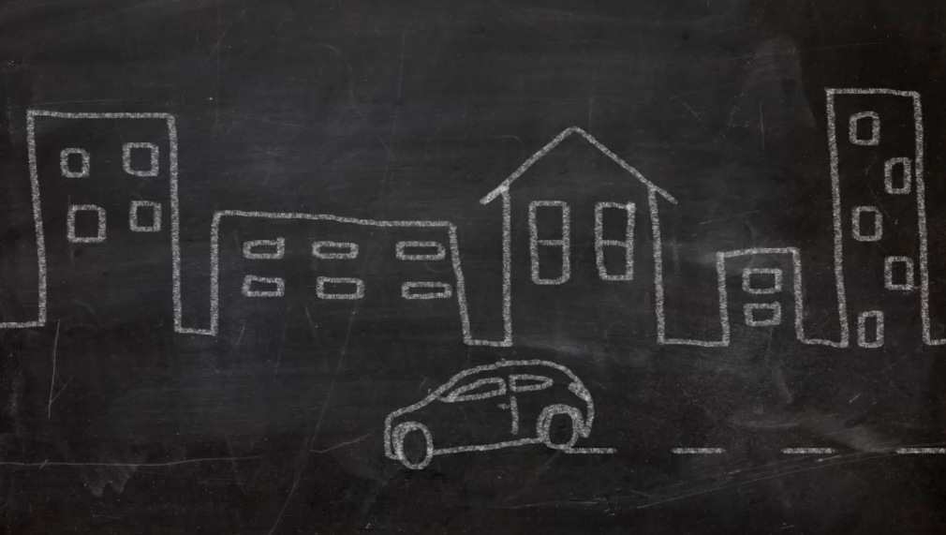
Personalized medicine in urban settings.....

Slide 27
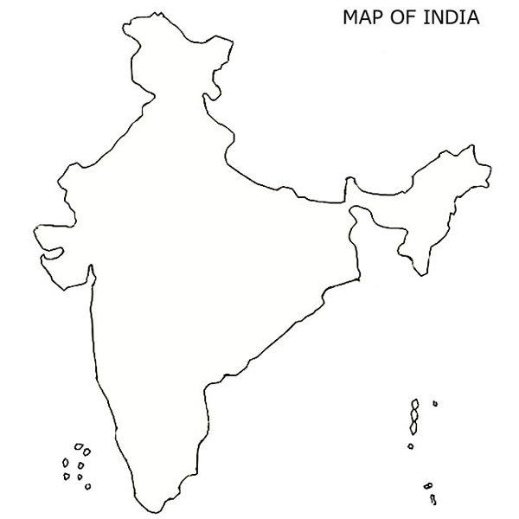
Era of Geographic Medicine… predicting the next epidemic

Slide 28
Honestly, we think it's 1.2 billion.
Probably, that's why we call it the PULSE OF A BILLION

Slide 29
And it just so happens ……. That our dream of a billion, is also an Innovation for a BEtter TOmorrow
Yours sincerely,
Team PULSE OF A BILLION

